Slide 1
The Cumberworth Radical Retrofit, West Yorkshire. Designed and Built by
Leading to
Carbonlite Retofit Certification

Slide 2
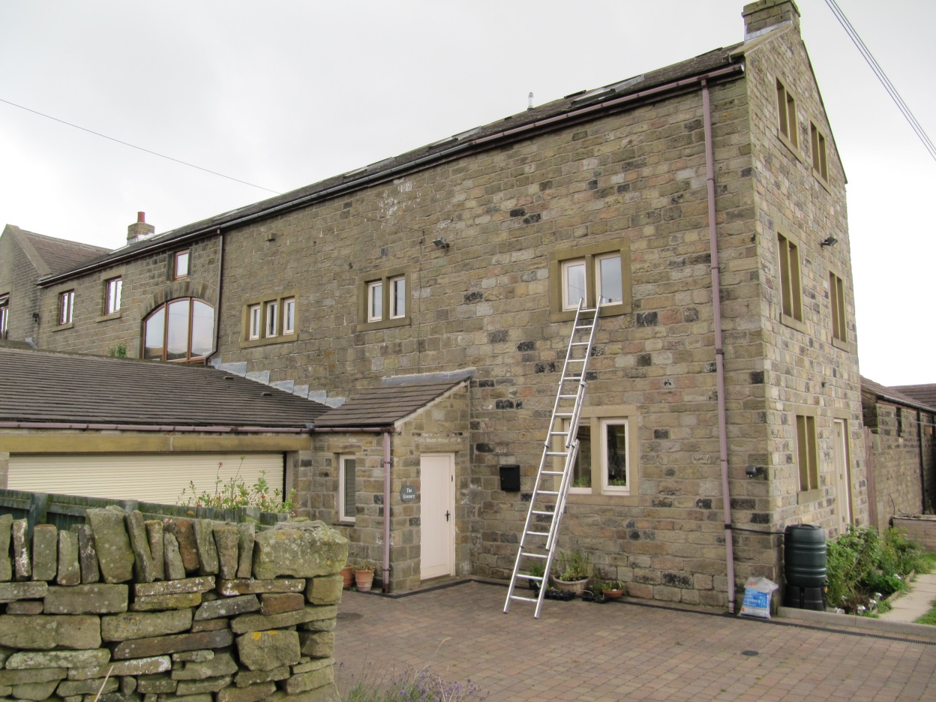
Design Stage Data, a Whole House Strategy
19th Century rubble filled Yorkshire Sand Stone Barn converted 1992
Cavity masonry wall extension built 1992

Slide 3
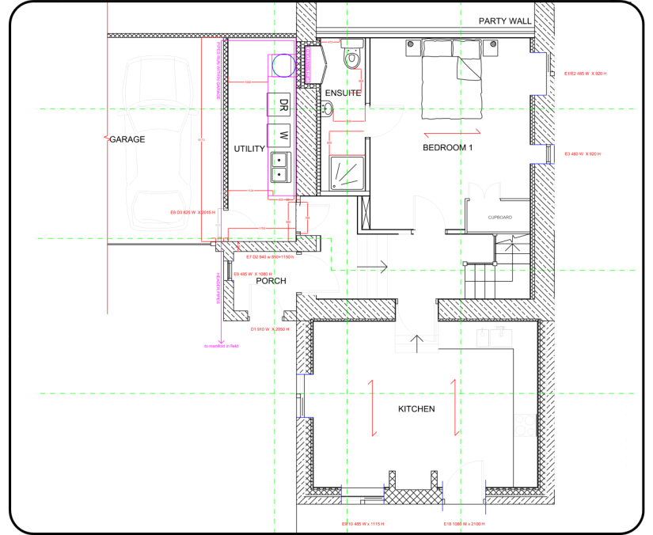
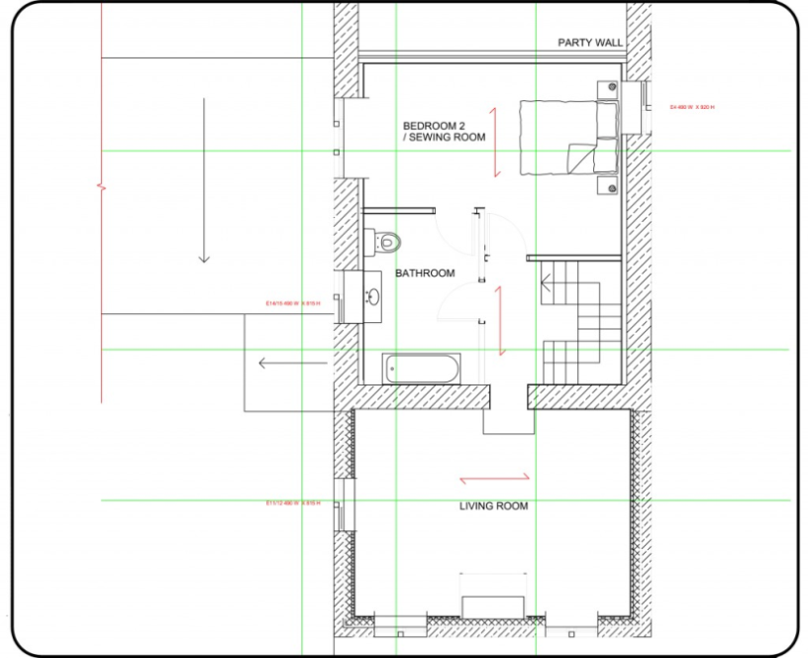
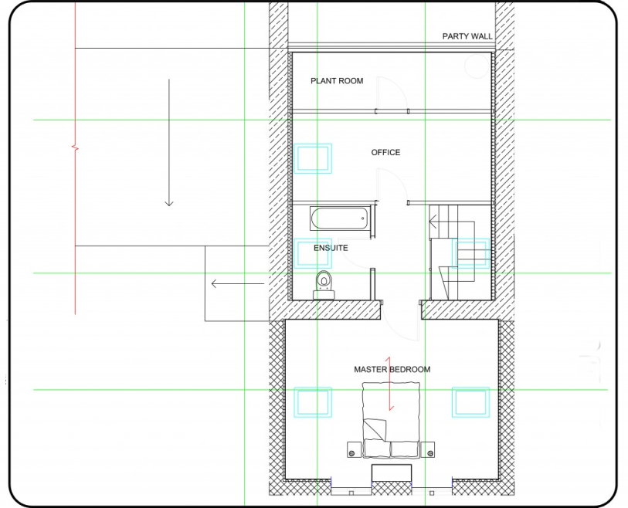
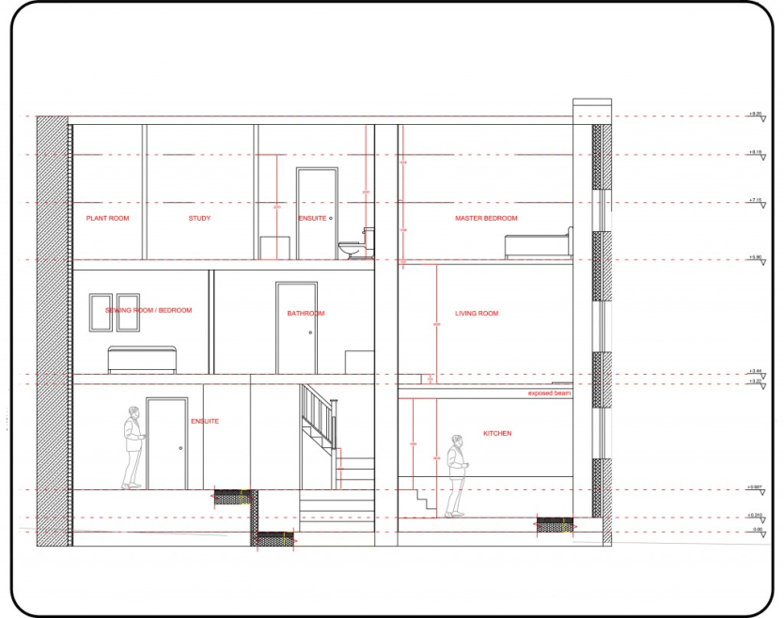
Treatable floor area (tfa), Form Factor
Existing floor area 151m2
Proposed tfa 136m2, Form Factor 2.7

Slide 4
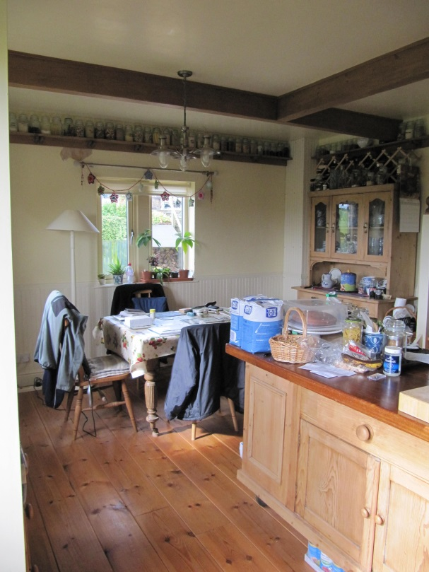
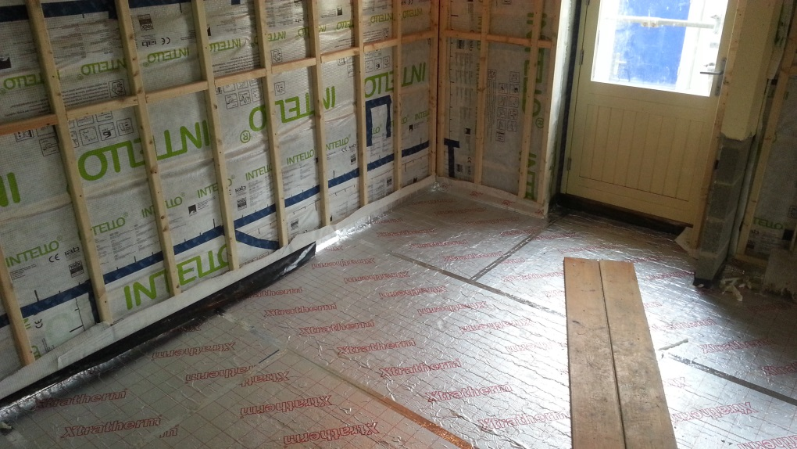
Ground Floor
Existing Ground floor, 50mm polystyrene, 100mm concrete, softwood floor boards on battens.
Proposed, 100mm concrete slab, 200mm PU,
75mm screed with underfloor heating, ceramic tiling, 0.12 U Value.

Slide 5
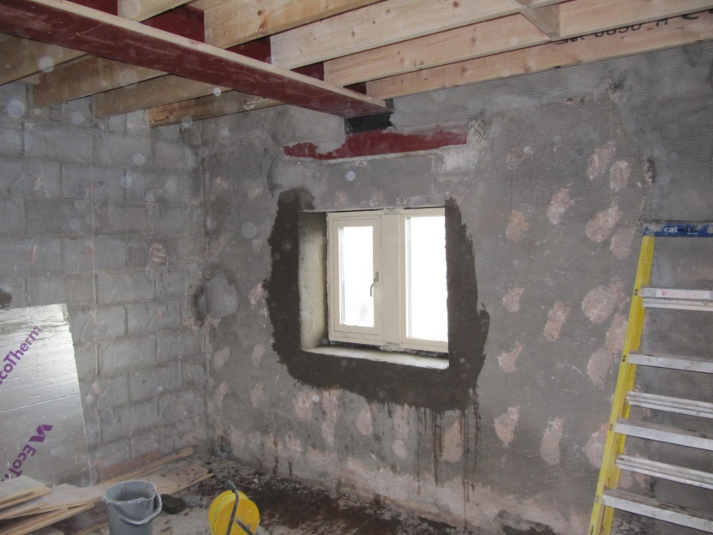
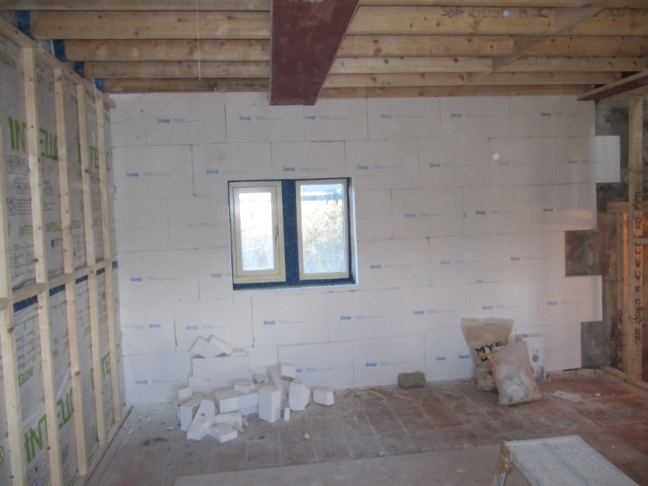
Barn external walls
Existing ‘barn’ external walls, 450mm sandstone in two leaves with occasional through stones, rubble filled, lime/sand mortar, parged in 1990 conversion, dot and dab plasterboard.
Proposed IWI strategy, 100mm TecTem perlite insulation with appropriate lime finish, designed for a 0.35 U Value.

Slide 6
Wall Moisture Risks
Barn Conversion,
Solution; Sand and cement render with water inhibitor to 1m, capillary and vapour open insulation methodology, external brick cream?
Risks with IWI;
Rising damp, rain driven moisture, interstitial condensation.
Rubble filled stone barn walling.
WUFI analysis

Slide 7
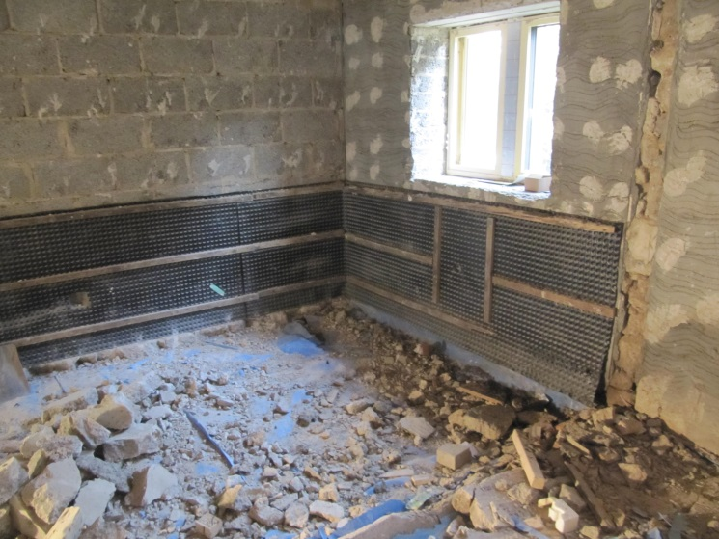
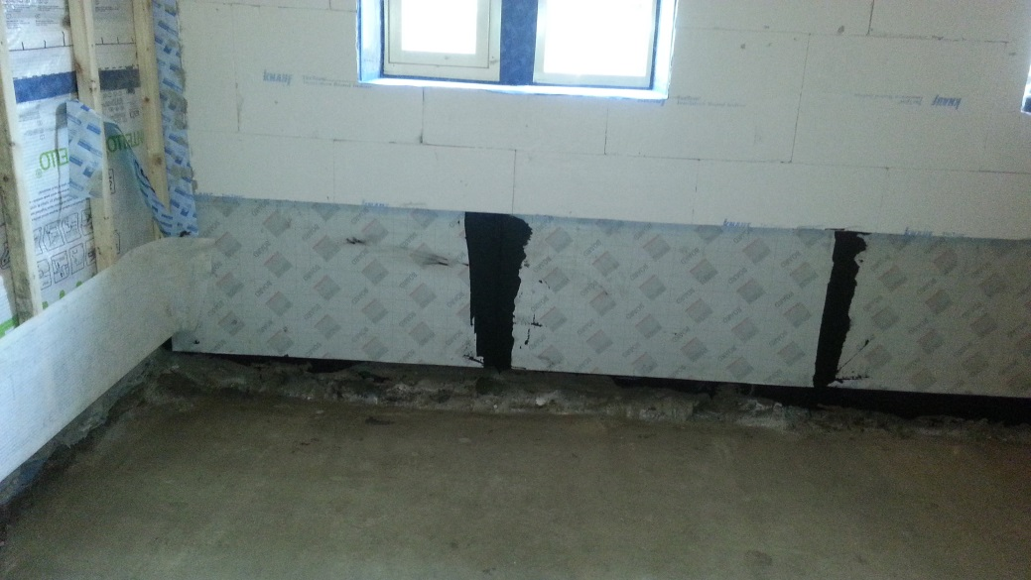
Tanking Strategy to Barn wall
Existing ground floor walling below ground, 1990 plastic tanking, timber battens, plasterboard and skim.
Proposed integration of FoamGlas with TecTem.

Slide 8
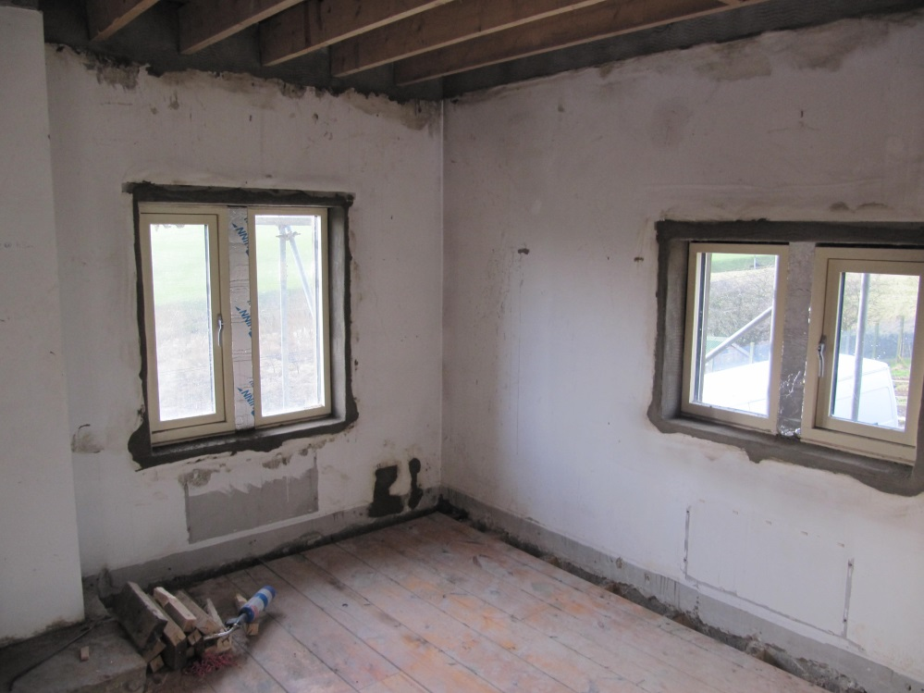
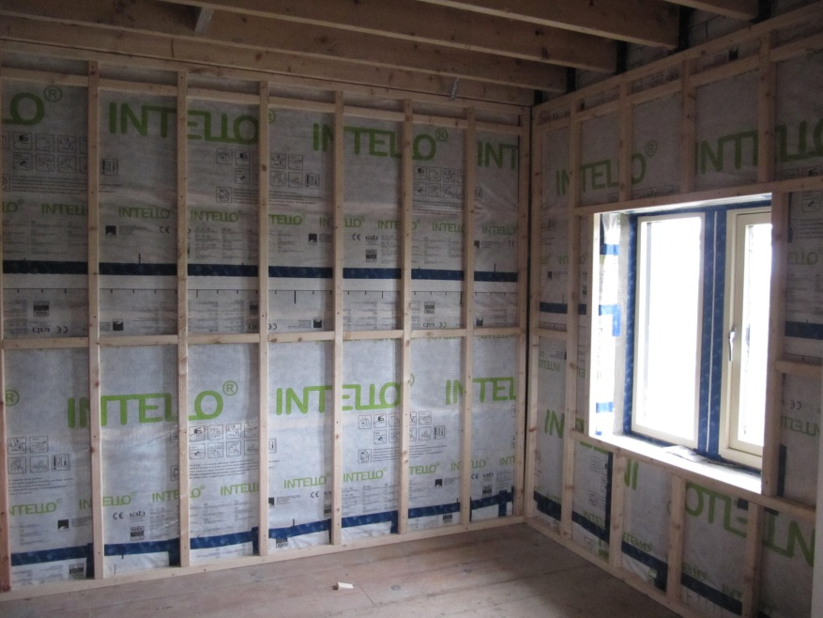
Extension
Existing ‘extension’ external wall, 150mm coursed sandstone, sand cement mortar, 50mm cavity, stainless steel wall ties, 100mm lightweight concrete ‘poly blocks’, two coat gypsum plaster.
Proposed to leave as is apart from parging reveals to existing windows, 100mm DriTherm mineral wool batts, extruded poly studs, taped intelligent airtightness membrane, service void, plasterboard and skim, 0.30 U Value.

Slide 9
Wall Moisture Risks
Extension Cavity Wall,
Solution;
Mineral dry wall system with insulated studs, moisture diffusive vapour control membrane, careful taping of timber joists.
Risks with IWI;
Bridging rain driven moisture, water vapour in cavity from driven rain, interstitial condensation.
Cavity masonry with modern plastic dpc and cavity trays.
WUFI
Analysis

Slide 10
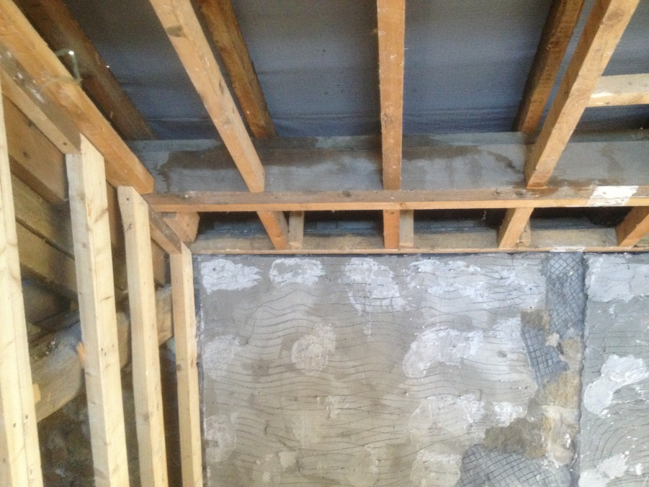
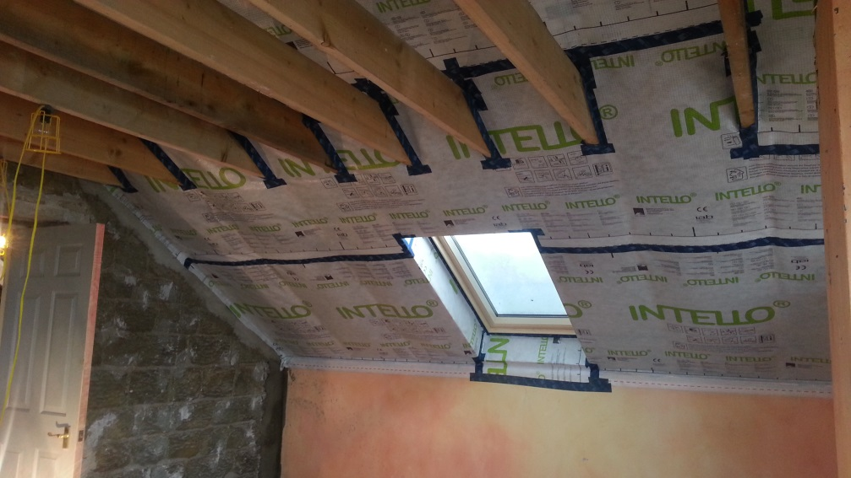
Roof Strategy
Cathedral ceiling, Sandtoft tiles, timber truss, purlin and rafter, plasterboard and skim, recessed ceiling lights!
Proposed, re cover, wind tight vapour open membranes and tapes, 300mm mineral wool, intelligent vapour control membrane and tapes, 50mm PU, plasterboard and skim, 0.15 U Value.

Slide 11
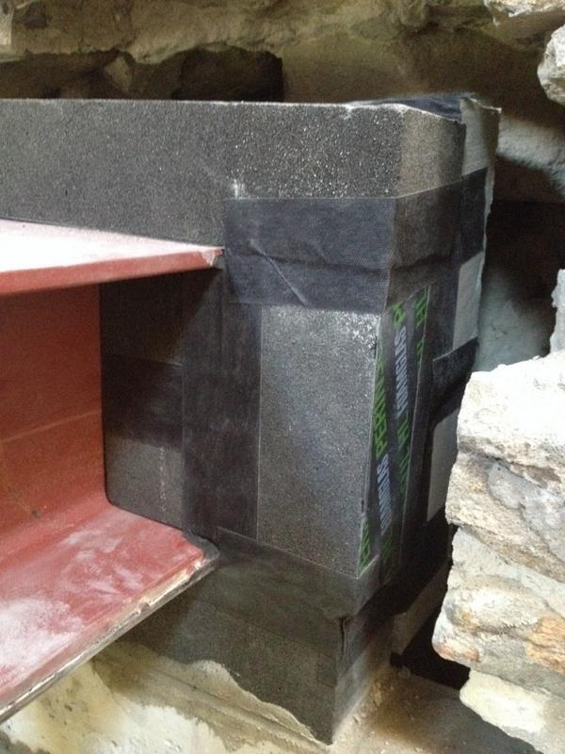
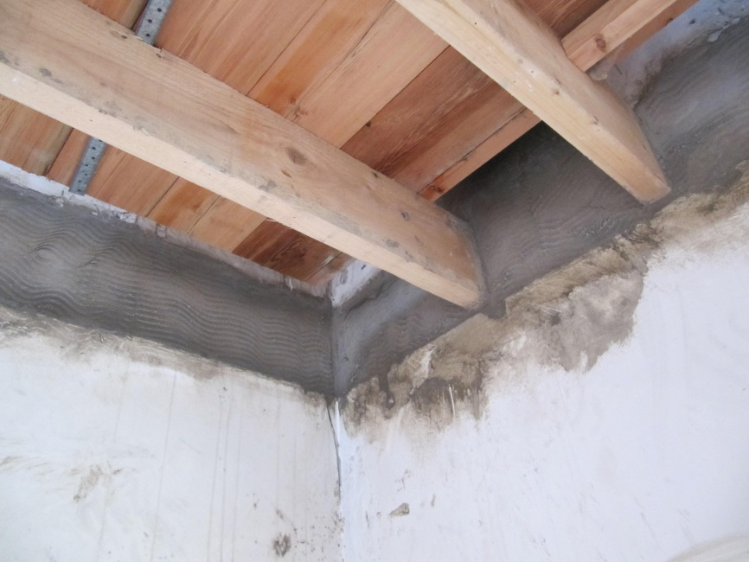
Intermediate Floor Strategy
Barn, keep all timber joists out of external stone walls, support with steel joists isolated by FoamGlas.
Extension cavity wall leave existing timber joists in block inner leaf, parge between joists, and tape to vapour control membrane.

Slide 12
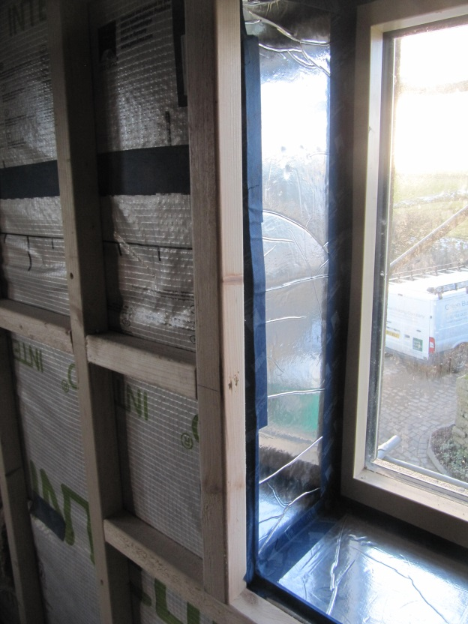
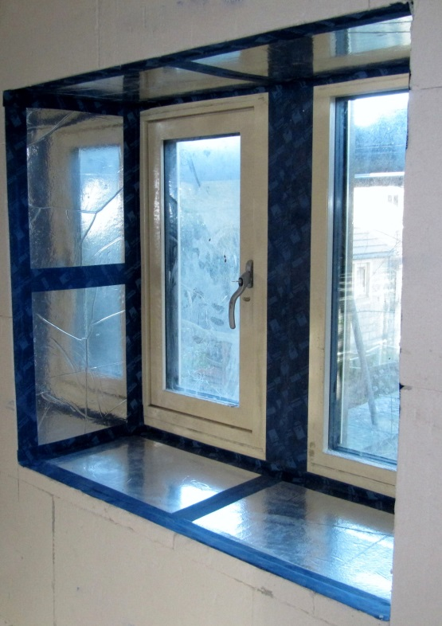
Windows and Ext Doors
Existing timber triple glazed outward opening timber windows and doors installed approx 2012, 0.9 U Value.
10mm Custom made 10mm Vacuum Insulated Panels to reveals at 0.007 Lamda Value, taped as part of airtightness strategy.

Slide 13
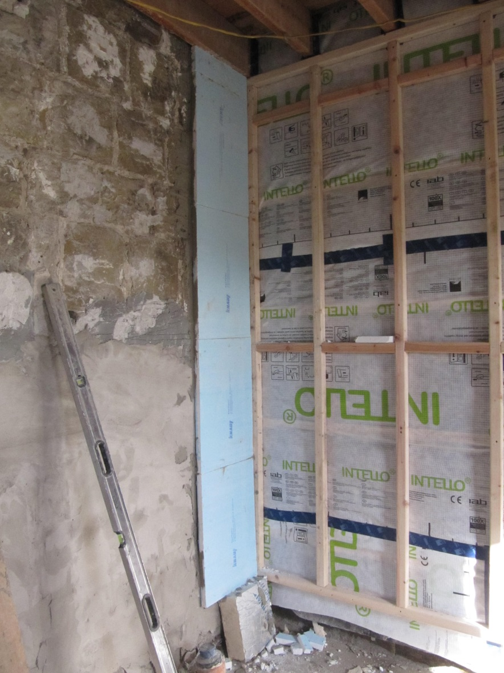
Thermal Bridging
Main thermal bridge
is the old barn gable end
wall now an internal
partition wall.
Psi values calculated
using Therm software.

Slide 14
Energy Modelling and Strategies
Pre retrofit actual heating demand to a nominal 18C 209Kwh/m2/annum.
LPG traditional balanced flue boiler wet central heating, panel radiators.
Space heating only wood burning stove used extensively in living room.
Indirect domestic hot water cylinder with 50mm PU
Cooking LPG hob and electric oven.
LPG cost per annum “over 3k”

Slide 15
Energy Modelling and Strategies
Risk and comfort came first in our thinking, energy considerations followed.
We used PHPP at design stage but only after designing safe, pragmatic and buildable insulation solutions.
We designed to an air tightness of 3ach/hr.
PHPP calculated a heating demand of 65Kwh/m2/annum.

Slide 16
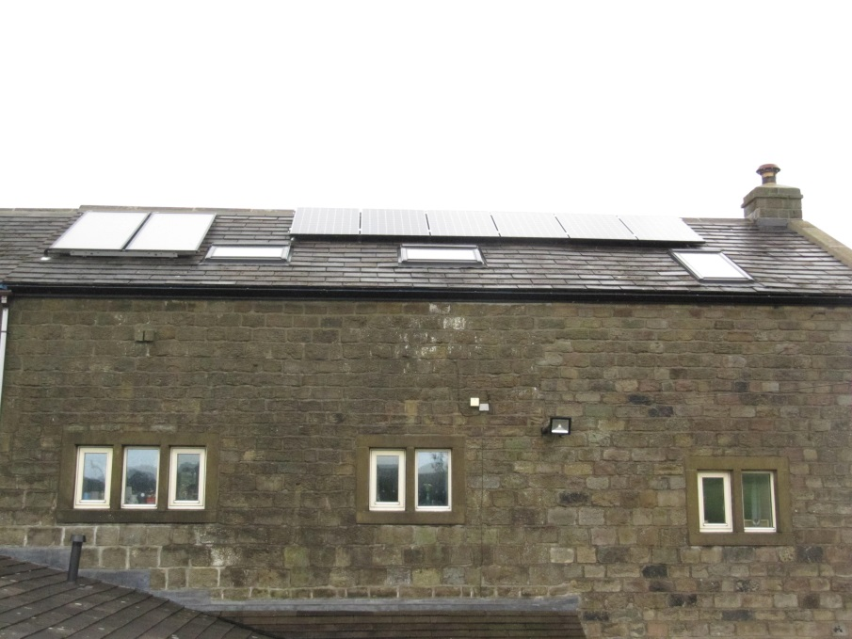
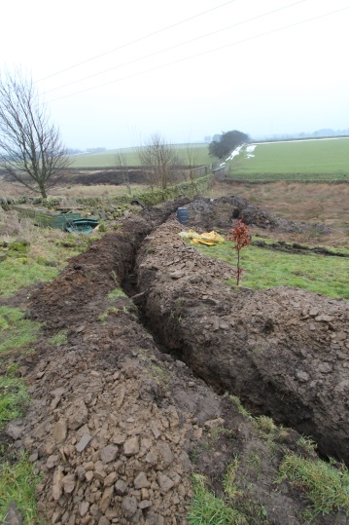
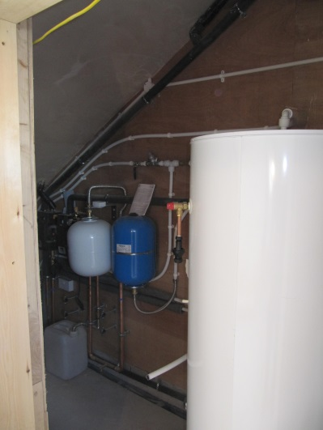
Heating Strategy and Hot Water
Domestic hot water, ground source heat pump and 7m2 Solar Thermal, 300 litre thermal store.
Ground source heat pump, underfloor heating to ground floor, panel rads 1st and 2nd floors.
10m2 Photovoltaic array
4Kw wood burning stove!

Slide 17
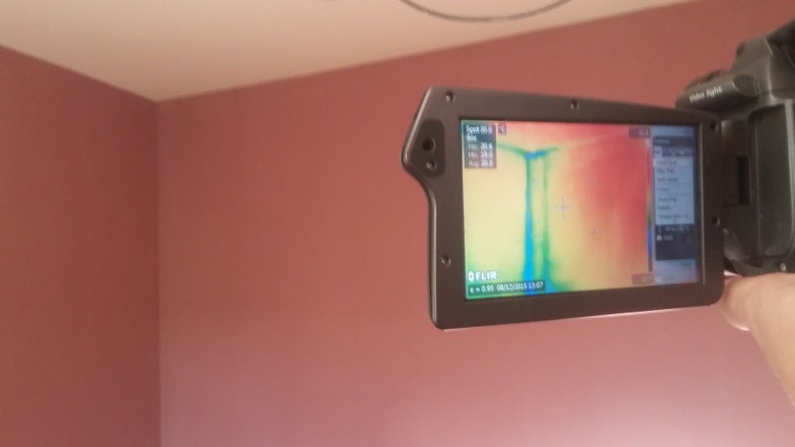
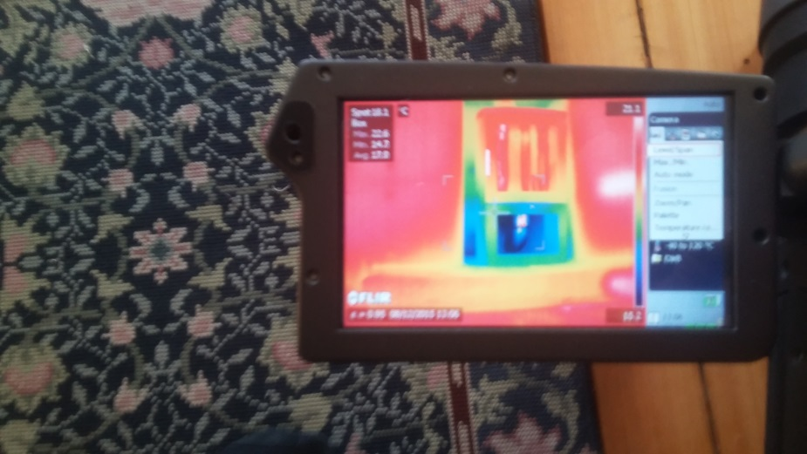
Airtightness Strategy
Continuity of concrete screed, vapour control membrane with appropriate tapes, parging where necessary, TecTem adhesive.
Target 3ach/hr @ 50 pascals.
Achieved 2ach/hr @ 50 pascals after removing “room sealed wood burning stove”
Big stone partition wall should have been treated as well as the external walls!!!

Slide 18
Expected Results
 | Fuel | Heating system | Space Heating - at 20 degrees int. temp |  |  | Space Heating – at int. temps shown below
 |  |  | kWh/(m2.a) heat required | £/a fuel delivered | kg CO2/a fuel delivered | Actual internal temp | kWh/m2.a heat required | £/a fuel delivered | kg CO2/a fuel delivered
Original House | LPG | Boiler | 209 | 2840 | 7839 | 18 °C | 176 | 2382 | 6575
PHPP Predicted Retrofit | Electric | GSHP & ST DHW | 65 | 110 | 1189 | 20 °C | 65 | 110 | 1189
Actual Retrofit | _ ,, _ | _ ,, _ | 69 | 117 | 1267 | 22 °C | 78 | 132 | 1429
Reduction |  |  | 67% | 96% | 84% |  | 56% | 94% | 78%

Slide 19
