Slide 1

Feedback and post-occupancy data on 20 near Passivhaus retrofits
Marion Baeli

Slide 2
Content:
Retrofit for the Future and RIBA publication
RIBA Book
Monitoring results – Property 1, 2, 3, 4

Slide 3

POST OCCUPANCY EVALUATION | PRINCEDALE ROAD
1. retrofit for the future programme
Initiative from: Small Business Research Initiative (SBRI)
With: Local Government – Homes and Community Agency
Delivered by: Technology Strategy Board

Slide 4
Programme:
    Launched in 2009
    2 phase competition
    100 projects have been completed
    £150,000 funding per dwelling

Slide 5
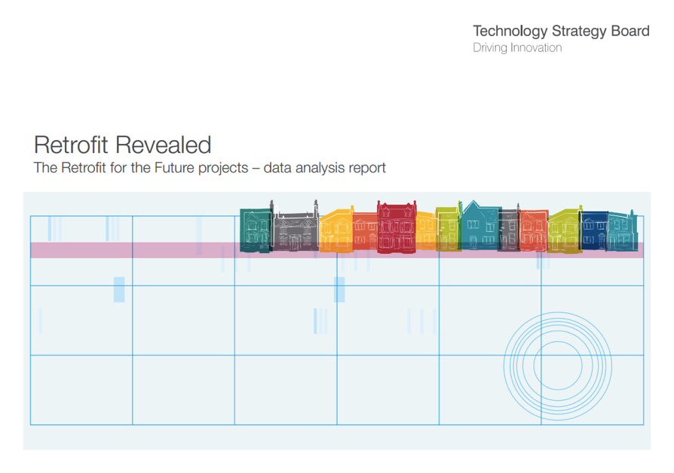
Programme official results:
www.retrofitanalysis.org

Slide 6
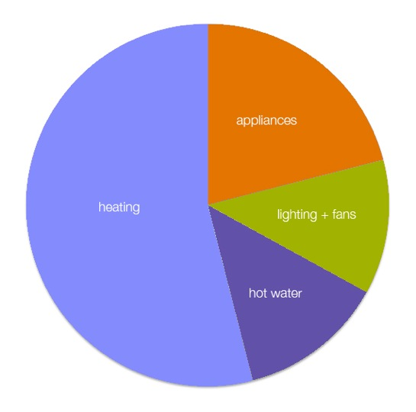
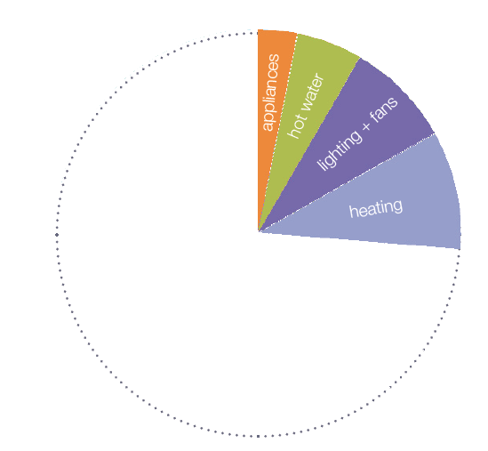
Aim:
80% CO2 reduction
Source of CO2 emissions in a standard Victorian House
TSB competition target

Slide 7
RftF Programme main targets:
80% reduction in CO₂ compared to 1990 emissions
CO₂ emissions limited to 17 kg/m².yr [20 kg/m².yr for PHPP]
Primary Energy limited to 115 kWh/m².yr [PassivHaus is 120kWh/m².yr ]
RftF Programme comfort monitoring:
Temperature
Relative Humidity
CO₂ concentration
(Occupant interviews)

Slide 8
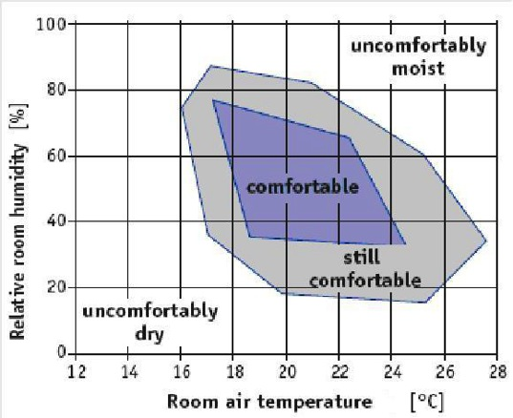
Comfort definition
Temperature:
~21ºC
Relative Humidity
~40 – 60%
CO2 concentration
~1000 – 1500ppm

Slide 9


POST OCCUPANCY EVALUATION | PRINCEDALE ROAD
2. book
residential retrofits, 20 case studies

Slide 10
Publication
Author: Marion Baeli
Co-Author: Technology Strategy Board
Publisher: RIBA
Funding & Copyright: Paul Davis + Partners

Slide 11
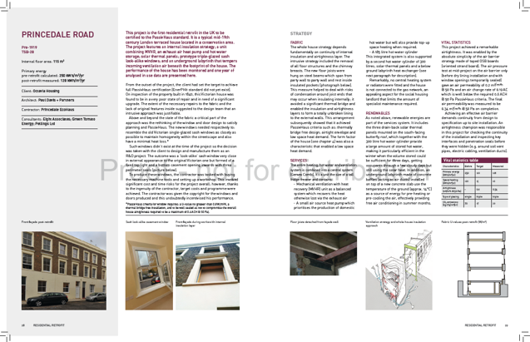
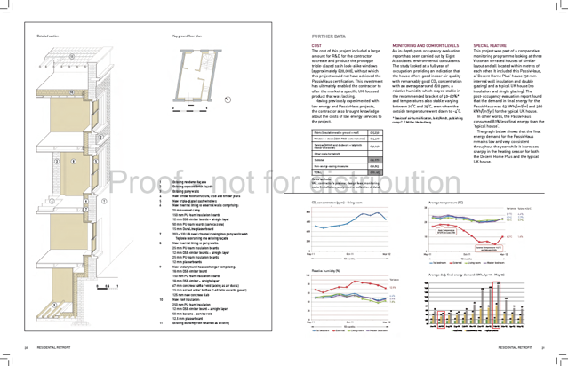
Content:
- ID card + summary of measures
- Description of each strategy
- Vital statistics
- Detailed isometric section
- Costs (material & labour)
- Monitoring data:
Energy & Internal comfort
- Special feature

Slide 12
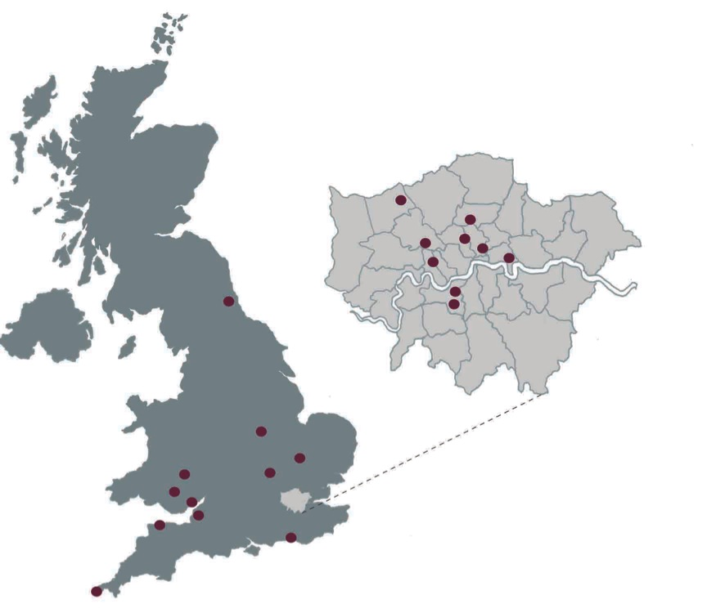
20 project locations

Slide 13
POST OCCUPANCY EVALUATION | PRINCEDALE ROAD
3. POE case studies

Slide 14
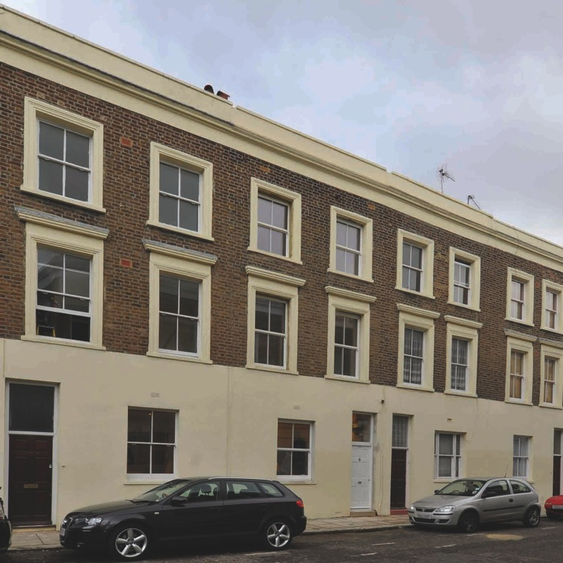


Property 1 (Princedale Road)
Victorian
Mid-terrace house
5 occupants

Slide 15
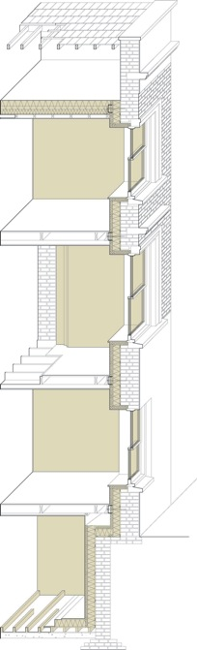
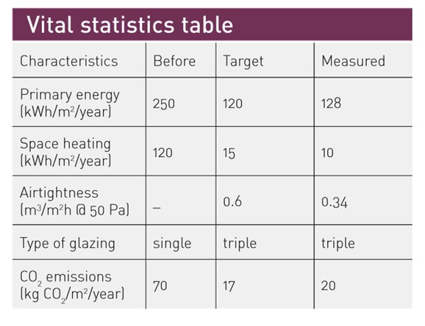
Property 1 (Princedale Road)
Fabric:
Continuous internal insulation
Triple glazing
No cold bridges (joist ends detached)
Services:
MVHR (Genvex Combi)
Solar thermal
Below ground heat exchanger
Airtightness
0.34 m3/m2h@50Pa

Slide 16
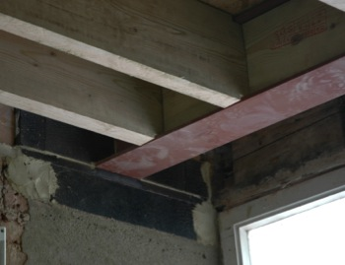
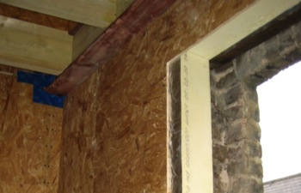
Joist end

Slide 17
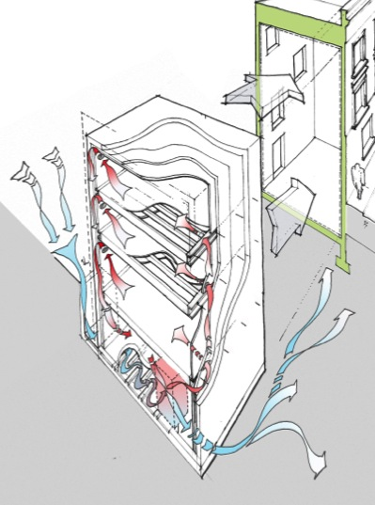
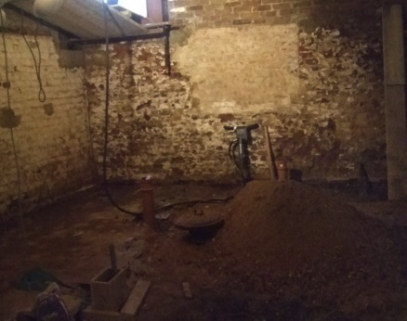
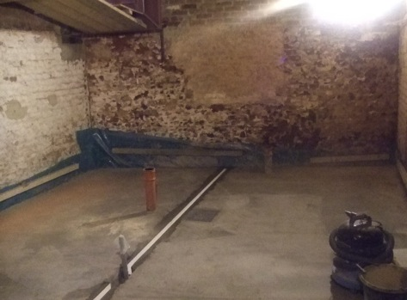

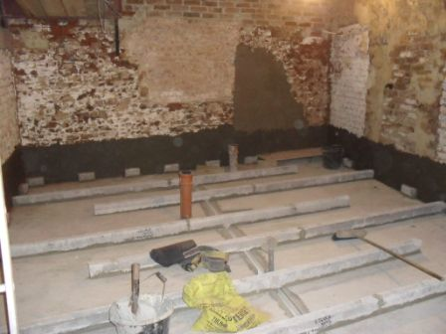
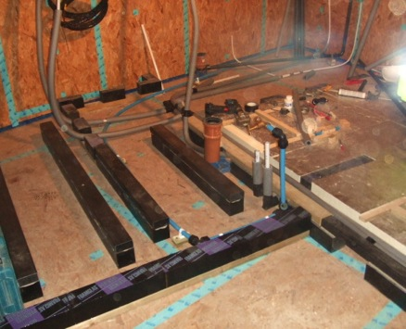
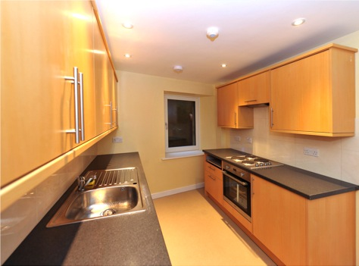
Underground Heat Exchanger
Foam Glass
OSB airtight layer
Insulation

Slide 18
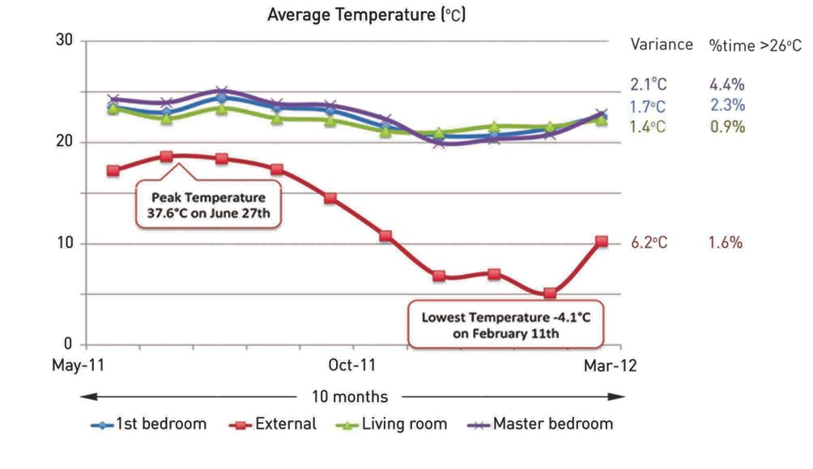

Slide 19
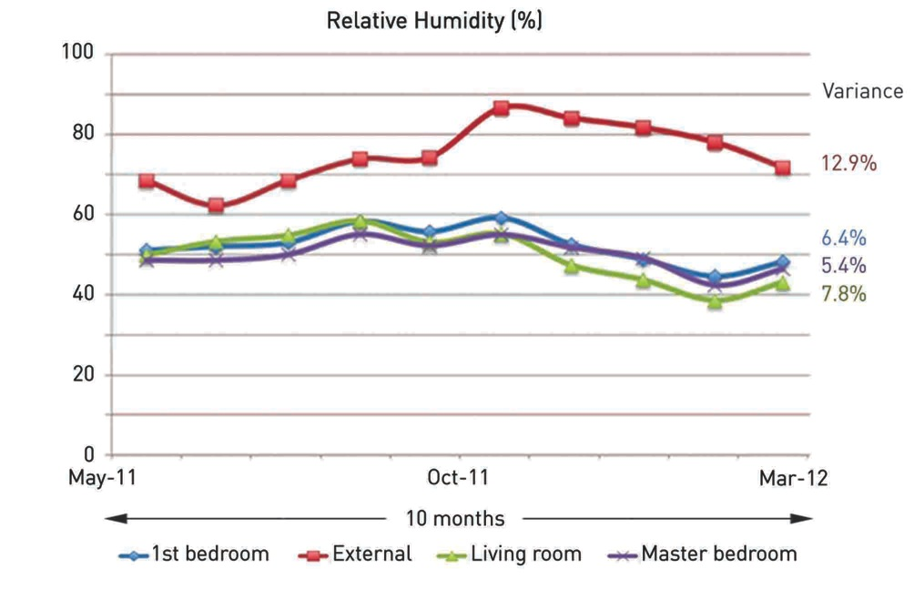

Slide 20
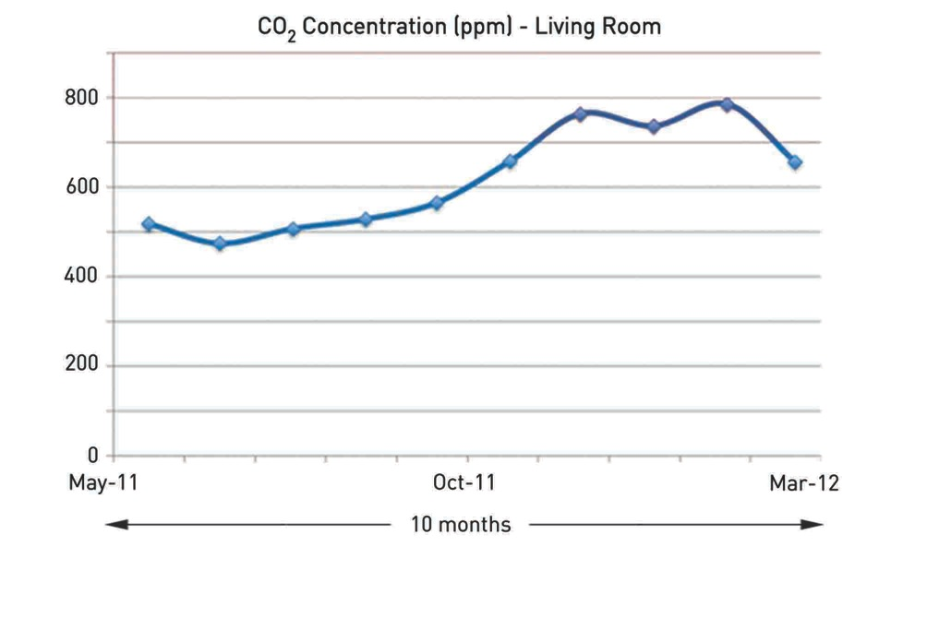

Slide 21
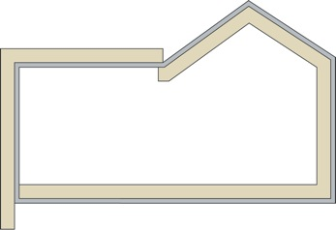
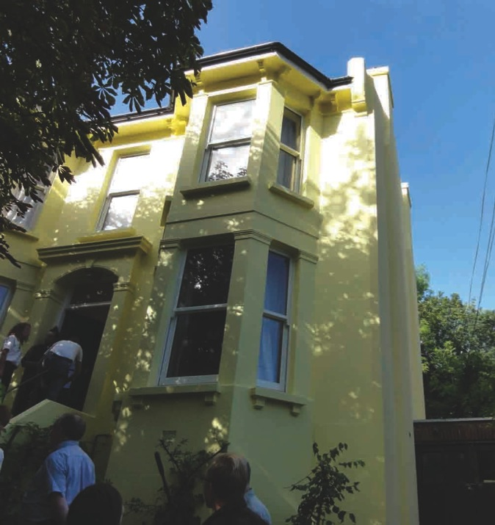
Property 2 (The Nook)
Victorian
Detached house
6 occupants (all adults)

Slide 22
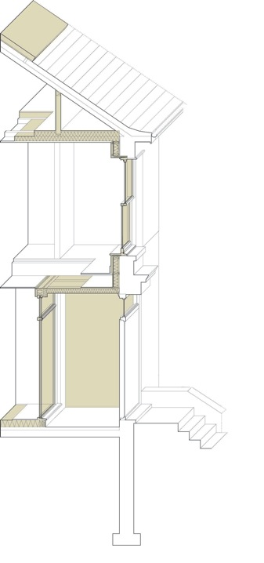
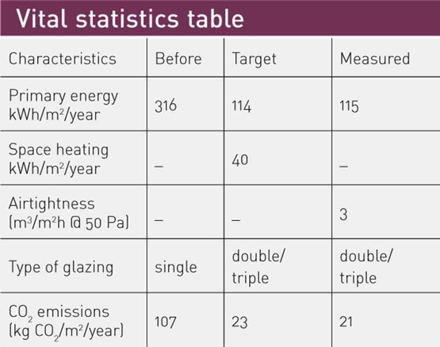
Property 2 (The Nook)
Fabric:
IWI & EWI
Triple & Double glazing
Some cold bridges (joist ends)
Services:
MVHR (Paul)
Gas boiler
Solar thermal
Airtightness:
3 m3/m2h@50Pa

Slide 23
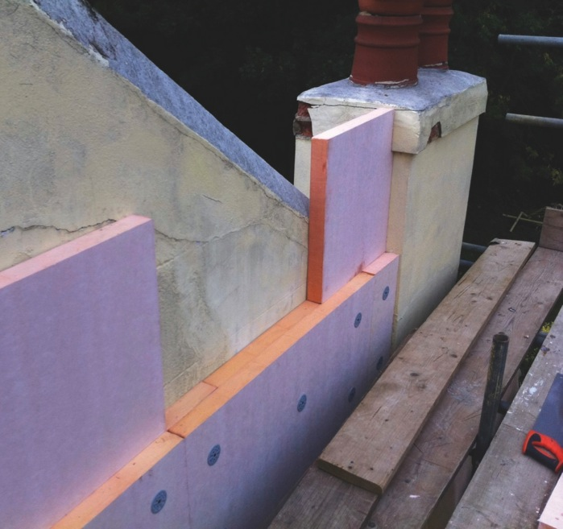

Slide 24
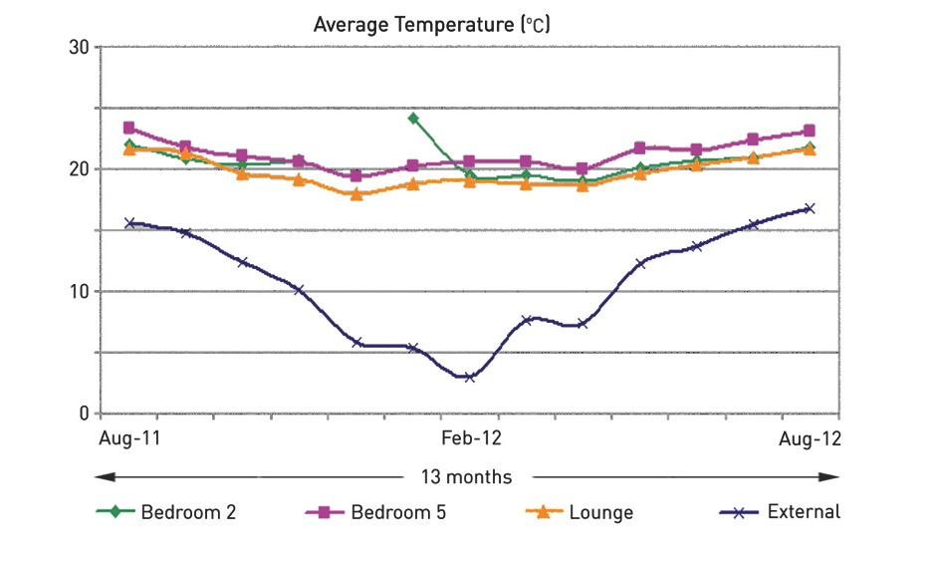
Property 2 (The Nook)

Slide 25
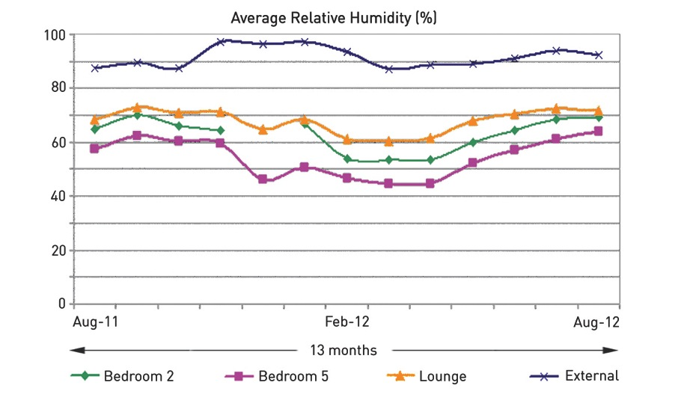
Property 2 (The Nook)

Slide 26
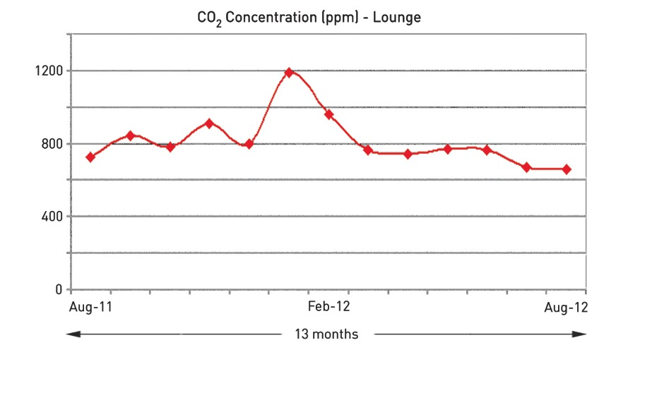
Property 2 (The Nook)

Slide 27

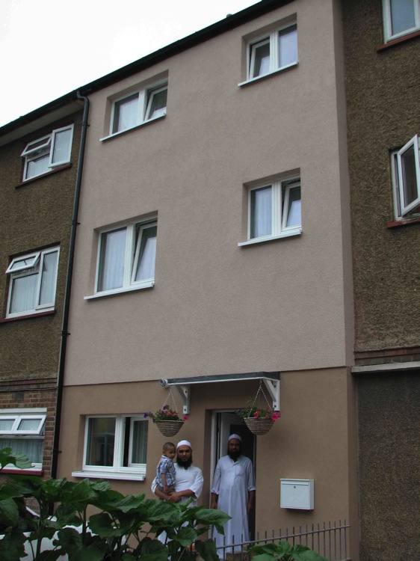
Property 3 (Passfield Drive)
1950’s
Terraced house
8 occupants (family)

Slide 28
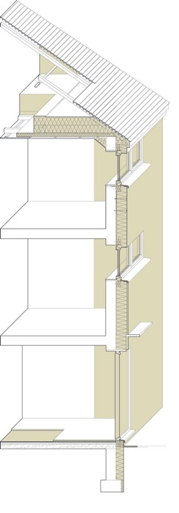
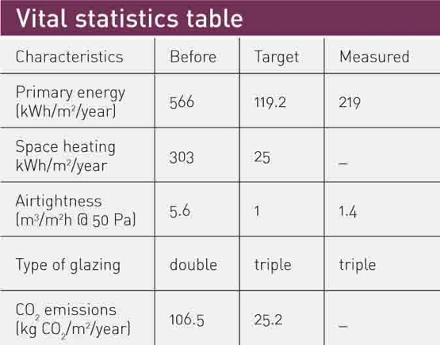
Property 3 (Passfield Drive)
Fabric:
EWI
Triple glazing
Minimal cold bridges (floor/wall)
Services:
MVHR (Paul)
Gas boiler
Solar thermal
Airtightness:
1.4 m3/m2h@50Pa

Slide 29
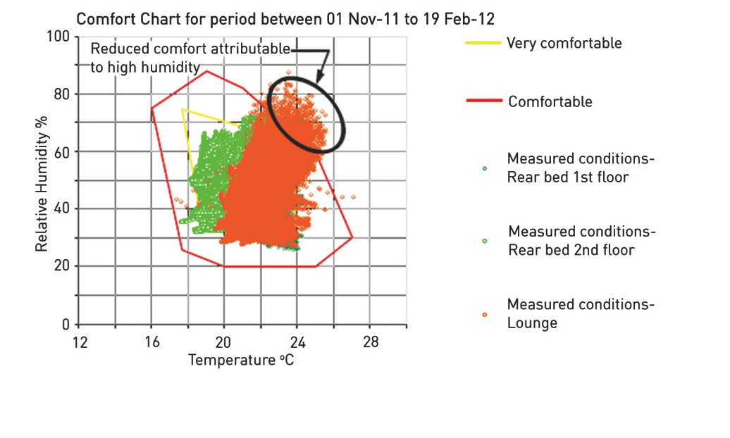
Property 3 (Passfield Drive)
(3.5 months)

Slide 30
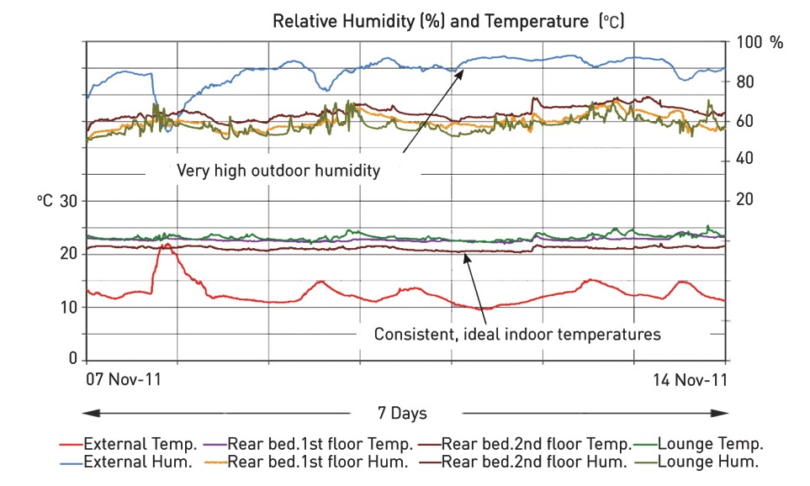
Property 3 (Passfield Drive)

Slide 31
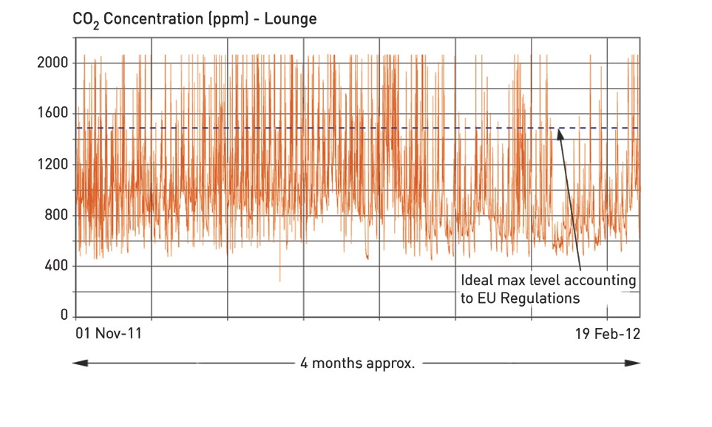
Property 3 (Passfield Drive)

Slide 32
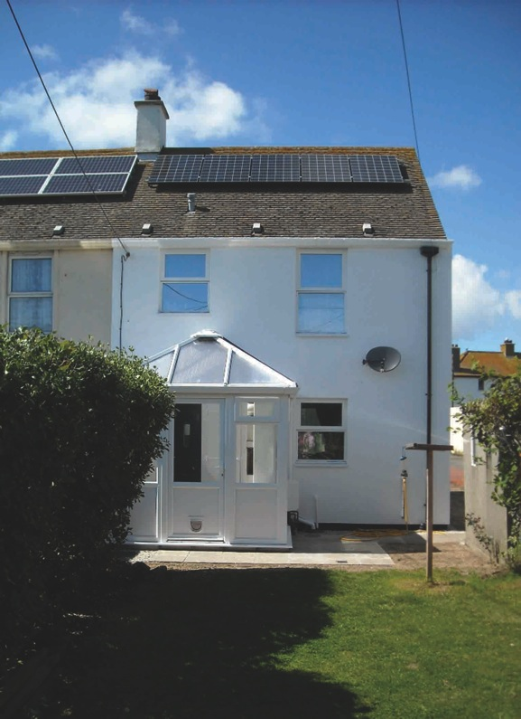
Property 4 - Penzance
1950’s
Semi-detached house
2 occupants

Slide 33
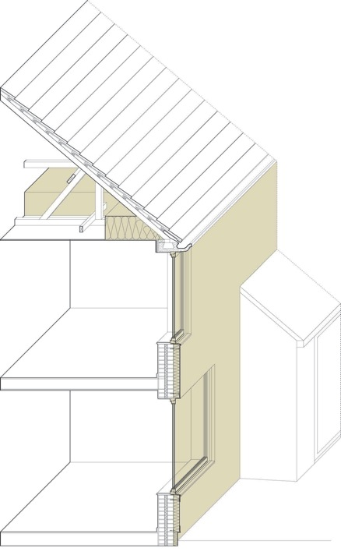
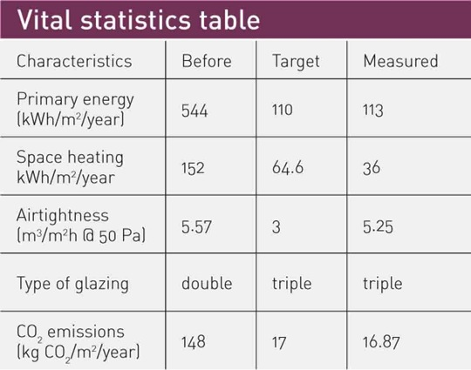
Property 4 - Penzance
Fabric:
EWI
Triple glazing
Minimal cold bridges (ground/wall)
Services:
MVHR
Ground source heat pump (Calorex 3.5 kW) & pressurised cylinder
‘Heat pod’ extension
Photovoltaic panels
Airtightness:
5.25 m3/m2h@50Pa

Slide 34
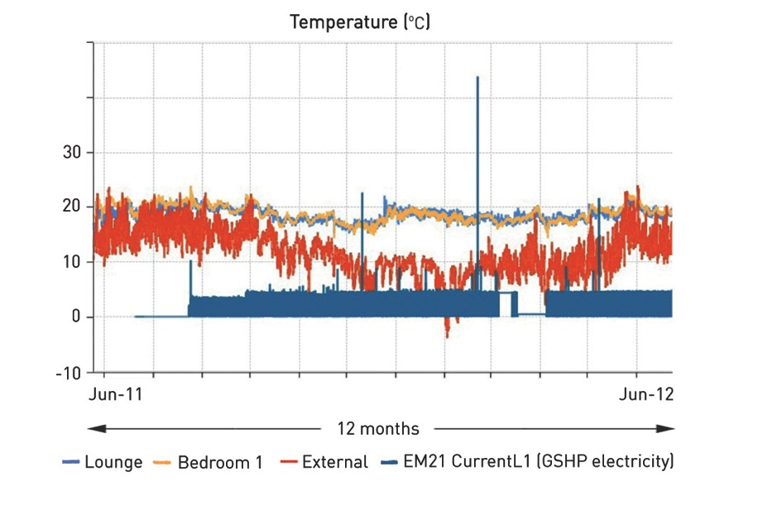
Property 4 - Penzance

Slide 35
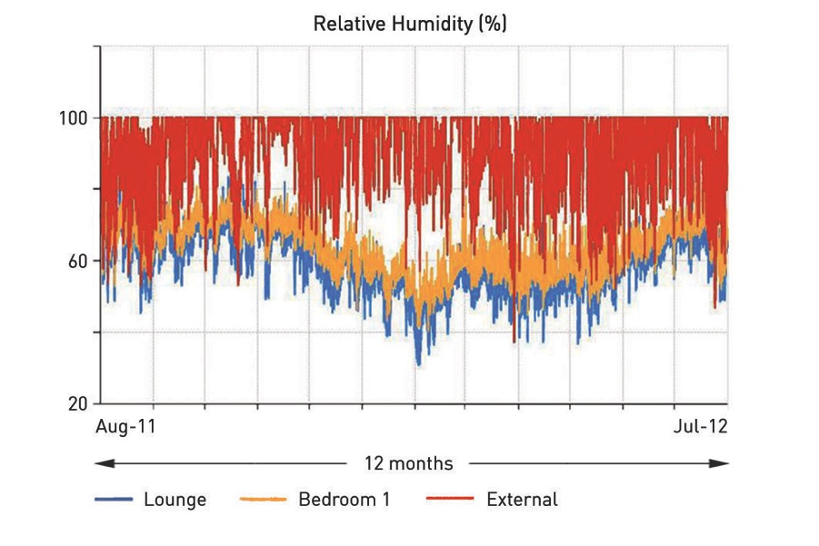
Property 4 - Penzance

Slide 36
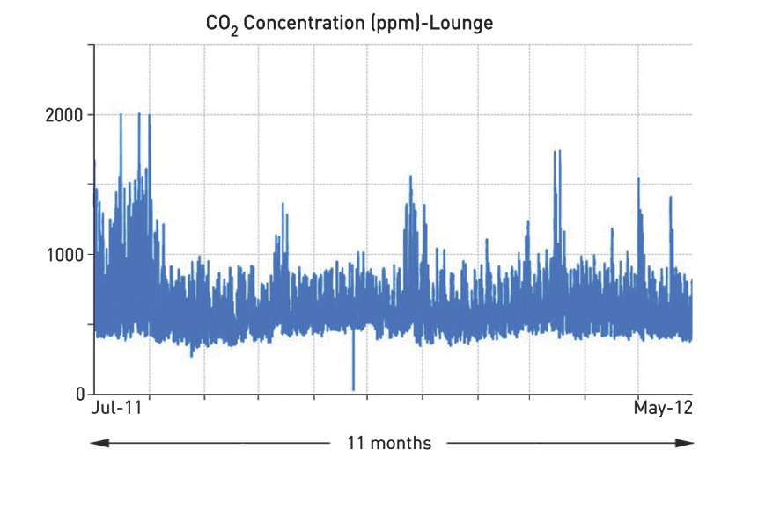
Property 4 - Penzance

Slide 37
POST OCCUPANCY EVALUATION | PRINCEDALE ROAD
conclusion

Slide 38
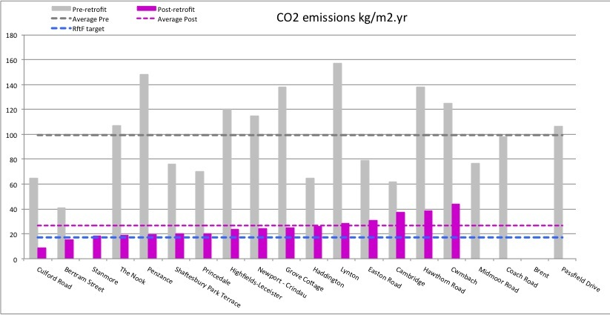
Results CO2 emissions
100
Average pre
26
Average post

Slide 39
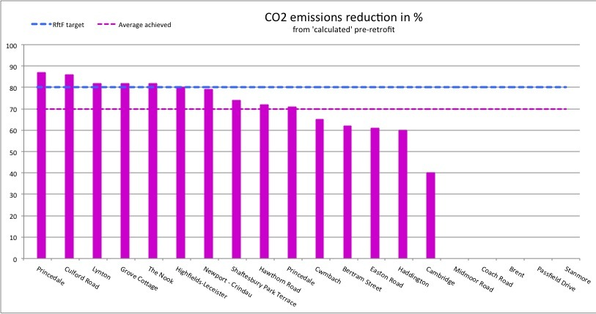
Results CO2 emissions reduction
70%
Average post

Slide 40
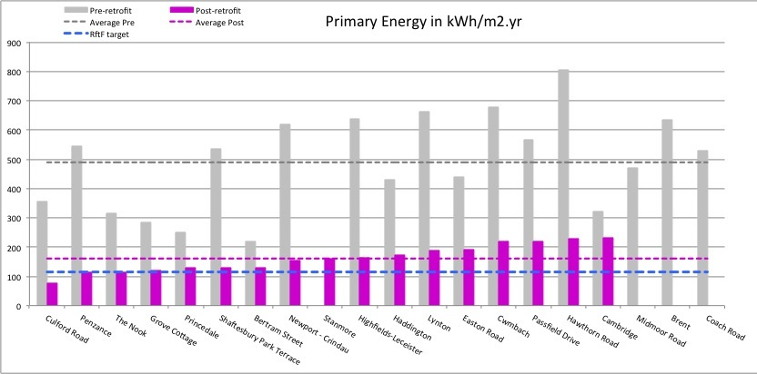
Primary energy demand
490
Average pre-retrofit
70%
reduction
161
Target
Average post-retrofit
3 projects out of 20 met the target for Primary Energy of 115 kWh/m2.yr

Slide 41
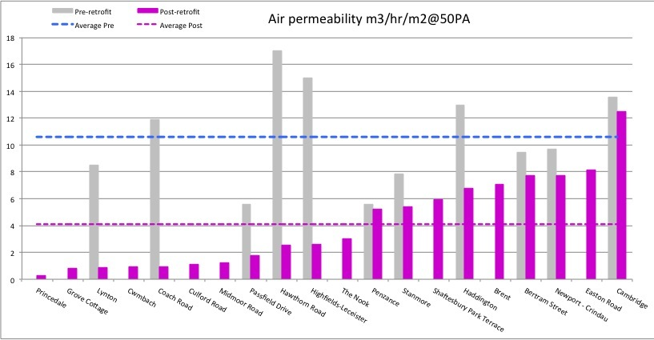
Air permeability
Pre
~11
Post
4
PassivHaus

Slide 42
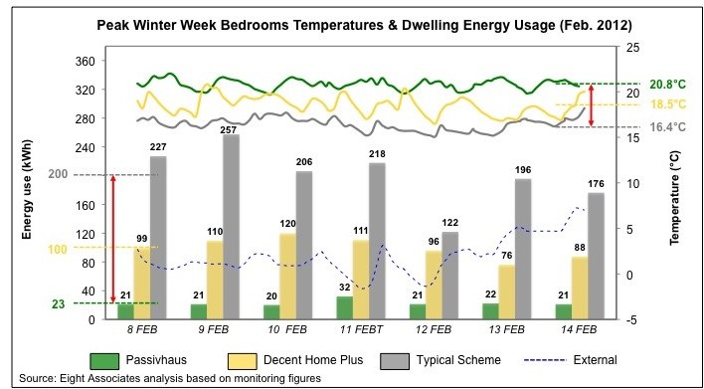

Princedale
More on → ‘2012 Conference Presentations’

Slide 43
Results on quality of internal comfort in these retrofits are
good and encouraging
More research needs to be undertaken on airtightness, costs,
  procurement, training, methodology…
Urgency of retrofitting the UK Housing Stock
Retrofit for the Future programme
A platform for engaging the industry into retrofits
The 20x case studies are a source of information and inspiration
for others

Slide 44





ribabookshops.com/retrofit
Thank you

